Slide 1

























The path through History at Earl Mortimer College
How did British society change during the industrial revolution?
What is History?
How has early migration shaped the UK?
How did the Normans take and secure power?
How did religion shape society in Medieval England?
To what extent did Medieval Monarchs lose power?
How did England change under the Tudors?
How did England’s political landscape change during the 17th and 18th centuries?
How did the industrial revolution impact on the world?
Year 7
Year 8
How did India become the ‘Jewell in the crown’ of the British Empire?
How did WW2 change the world?
What were the key moments of the Second World War – A Depth Study
What was it like to live in Nazi Germany?
Was World War Two Inevitable?
How significant was World War I?
How did Civil Rights in America change?
Year 9
How is Leominster linked to History?
What was life like in the trenches of World War One?
GCSE Starts – Health and Medicine
GCSE Unit 1
Health and Medicine
GCSE Unit 2
Conflict and WW1
Year11
GCSE Unit 3
Germany
GCSE Unit 4
Elizabeth
GCSE Revision & Exams
Year10

Slide 2
The path through Key Stage Three History at Earl Mortimer College
Year 7
What is History?
How has early migration shaped the UK?
How did the Normans take and secure power?
How did religion shape society in Medieval England?
To what extent did Medieval Monarchs lose power?
How did England change under the Tudors?
How did England’s political landscape change during the 17th and 18th centuries?
Year 8
What was life like in the trenches of World War One?
How significant was World War I?
How did India become the ‘Jewell in the crown’ of the British Empire?
How did the industrial revolution impact on the world?
Was World War Two Inevitable?
How did British society change during the industrial revolution?
Year 9
What were the key moments of the Second World War – A Depth Study
How did Civil Rights in America change?
GCSE Starts – Health and Medicine
What was it like to live in Nazi Germany?
How did WW2 change the world?
How is Leominster linked to History?

Slide 3













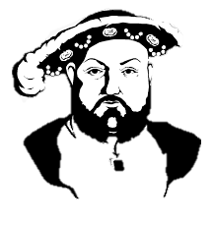

The path through Year 7 History at Earl Mortimer College
Year 7
What is History?
How has early migration shaped the UK?
How did the Normans take and secure power?
How did religion shape society in Medieval England?
To what extent did Medieval Monarchs lose power?
How did England’s political landscape change during the 17th and 18th centuries?
Year 8
vs
How did England change under the Tudors?

Slide 4













The path through Year 8 History at Earl Mortimer College
How did British society change during the industrial revolution?
Year 8
How did the industrial revolution impact on the world?
How did India become the ‘Jewell in the crown’ of the British Empire?
How significant was World War I?
Was World War Two Inevitable?
Year 9
What was life like in the trenches of World War One?

Slide 5








The path through Year 9 History at Earl Mortimer College
What was it like to live in Nazi Germany?
What were the key moments of the Second World War – A Depth Study
Year 9
How did WW2 change the world?
How did Civil Rights in America change?
GCSE Starts – Health and Medicine
Year 10
How is Leominster linked to History?

Slide 6
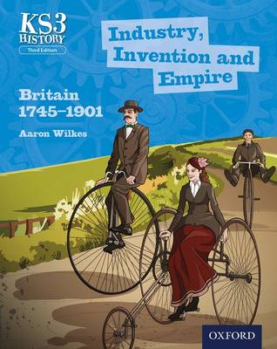
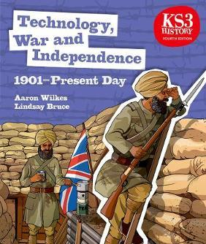









Seneca https://www.senecalearning.com/ a fantastic free resource for students to practice and retrieve their knowledge
BBC Bitesize https://www.bbc.co.uk/bitesize/subjects/zk26n39 has lots of really useful subject and exam board revision
Show My Homework https://www.showmyhomework.co.uk/login
will be used for all homework tasks.
YouTube has a wealth of resources, such as this playlist for Secondary History from BBC Teach https://www.youtube.com/playlist?list=PLcvEcrsF_9zI2dNGU9uUOWo9tenQi93UG
Retaining, recalling and retrieving knowledge learnt.
Encourage your son or daughter to start early, start now on their homework and revision.
Help them be organised. Create a workable homework timetable with them.
Let them talk. Talking with you about a topic or subject helps them visualise their knowledge.
Water and healthy food are vital for the brain to function properly. Make sure they are eating and drinking with you while they talk about their subject.
Exercise & fresh air. Go for a jog with them while they talk about their subject.

